Slide 1


GODREJ JERSEY
BLINKIT · SWIGGY · ZEPTO
Q-COMMERCE PERFORMANCE REVIEW
H1 2026
Read-out &
H2 Playbook
What worked, what didn't, and where we scale next
A data-backed walkthrough across Blinkit, Swiggy Instamart & Zepto — built on June '26 platform reports and Jan ‘26 → Jun '26 trend.
PREPARED FOR · BRAND LEADERSHIP | PERIOD · JAN - JUNE '26

Slide 2
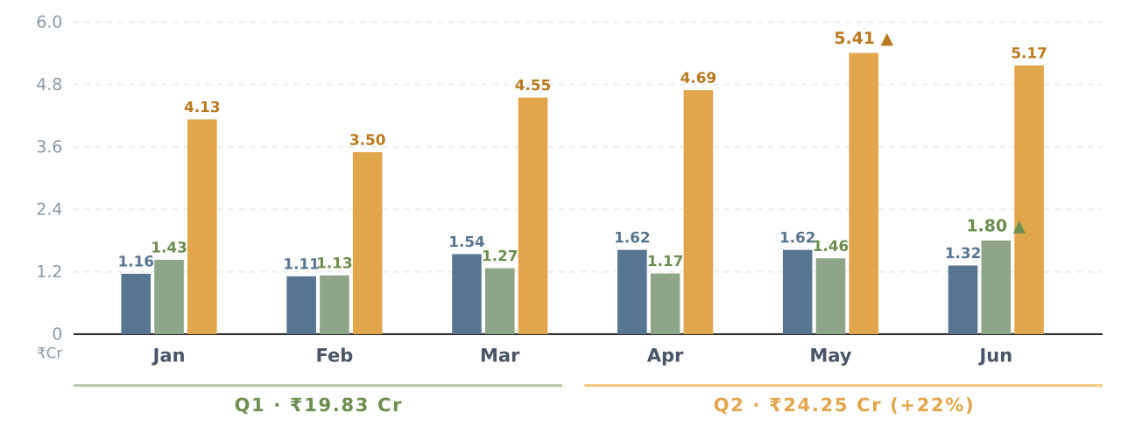
◆ H1 2026 SNAPSHOT
JAN '26 → JUN '26
H1 at a glance — ₹44 Cr GMV · ₹13.78 Cr Ad Sales · 5.09x blended ROAS
Every platform closed Q2 higher than Q1 · Blinkit leads on efficiency (6.69x) · Zepto delivers volume (₹9.55 Cr ad sales)
H1 GMV (JAN–JUN)
H1 AD SPEND
H1 AD SALES
H1 BLENDED ROAS
Q2 vs Q1 GMV GROWTH
₹44.08 Cr
₹2.71 Cr
₹13.78 Cr
5.09x
+22.2%
3 platforms combined
6.1% of H1 GMV
31.3% of H1 GMV
ACOS 19.6% blended
₹19.83 Cr → ₹24.25 Cr
Monthly total sales (₹ Crores)
BLINKIT · EFFICIENCY LEADER
Blinkit Swiggy Zepto
H1 GMV | ₹8.37 Cr | Ad Spend | ₹41.9 L
Ad Sales | ₹2.80 Cr | ACOS | 14.9%
H1 ROAS | 6.69x | Ad % GMV | 33.5%
Highest efficiency of the three · Apr peak GMV ₹1.62 Cr
SWIGGY · FASTEST EXIT MOMENTUM
H1 GMV | ₹8.25 Cr | Ad Spend | ₹28.9 L
Ad Sales | ₹1.42 Cr | ACOS | 20.3%
H1 ROAS | 4.92x | Ad % GMV | 17.2%
Jun ROAS 7.37x — H1 best month · biggest headroom on Ad-share
ZEPTO · VOLUME ENGINE
H1 GMV | ₹27.45 Cr | Ad Spend | ₹2.00 Cr
Ad Sales | ₹9.55 Cr | ACOS | 20.9%
H1 ROAS | 4.78x | Ad % GMV | 34.8%
62% of GMV · 69% of Ad Sales · Mar ROAS dip (2.40x) to fix
H1 read: ₹2.71 Cr ads returned ₹13.78 Cr sales (5.09x) · Zepto is 74% of spend and 69% of ad sales · Blinkit's 6.69x proves the efficiency ceiling · Swiggy's June ROAS 7.37x signals the H2 opportunity.
Source: Monthly GMV from platform SKU-level sales sheets · Ad performance from Blinkit, Swiggy Instamart & Zepto Jan–Jun '26 reports · ROAS = Ad Sales ÷ Ad Spend · ACOS = Ad Spend ÷ Ad Sales.

Slide 3
📈 PERFORMANCE TREND
Jan ‘26 → JUN '26
Six-Month Sales Trajectory
Monthly Total Sales (₹ Lakhs) across Blinkit, Swiggy Instamart & Zepto — showing the shape of H1
Monthly Total Sales (₹ Lakhs)
Blinkit Swiggy Zepto
Trend read-out
+50.5%
Zepto Peak
5.4Cr
SWIGGY GROWTH
Feb '26 (₹1.13 Cr) → Jun '26 (₹1.80 Cr). Compounding since April SILB shift & May day-parting.
+12.6%
ZEPTO H1 GROWTH
Dec '25 (₹4.59 Cr) → Jun '26 (₹5.17 Cr). Peaked in May at ₹5.41 Cr - sequential correction in June.
Swiggy New high
1.8Cr
−18.4%
Blinkit Dip
18%
BLINKIT MoM (JUN)
₹1.62 Cr (May) → ₹1.32 Cr (Jun). April slot-shift muted top-line; needs SB reinforcement & day-parting rollout.
Source: SKU-level Sales sheets — Blinkit, Swiggy & Zepto (Dec '25 – Jun '26). All values in ₹ Lakhs. Directional analysis; correlation not causation.

Slide 4
▤ EXECUTIVE SUMMARY
JERSEY | June '26
June performance snapshot
H1 '26 combined performance across Blinkit, Swiggy Instamart & Zepto
TOTAL GMV (JUN’26)
TOTAL AD SPEND
BLENDED ROAS
AD-SALES SHARE OF GMV
₹8.29 Cr
₹48.5 L
4.88x
28.6%
■ Zepto lead · 62% share
↗ Deployed across 3 platforms
Ad Sales ₹2.37 Cr / Spend ₹48.5 L
Highest on Blinkit (35.2%)
Platform snapshot –June '26
PLATFORM | TOTAL SALES | AD SPEND | AD SALES | ROAS | ACOS | AD-SALES % | MoM (GMV)
Blinkit | ₹1.32 Cr | ₹7.31 L | ₹46.5 L | 6.35x | 15.7% | 35.2% | −18.4%
Swiggy Instamart | ₹1.80 Cr | ₹4.25 L | ₹31.3 L | 7.37x | 13.6% | 17.4% | +23.2%
Zepto | ₹5.17 Cr | ₹36.9 L | ₹1.59 Cr | 4.31x | 23.2% | 30.7% | −4.4%
TOTAL | ₹8.29 Cr | ₹48.5 L | ₹2.37 Cr | 4.88x | 20.5% | 28.6% | Mixed
Read-out: Swiggy is our efficiency engine (ROAS 7.4x, +23% MoM). Zepto is our volume engine (62% of GMV) but leaks efficiency at ACOS 23%. Blinkit dipped in June — recoverable via SILB/day-parting playbook already piloted in May.
Source: Blinkit, Swiggy Instamart & Zepto June '26 platform reports · ROAS = Ad Sales ÷ Ad Spend · Blinkit ACOS calculated from Spend ÷ Ad Sales.

Slide 5
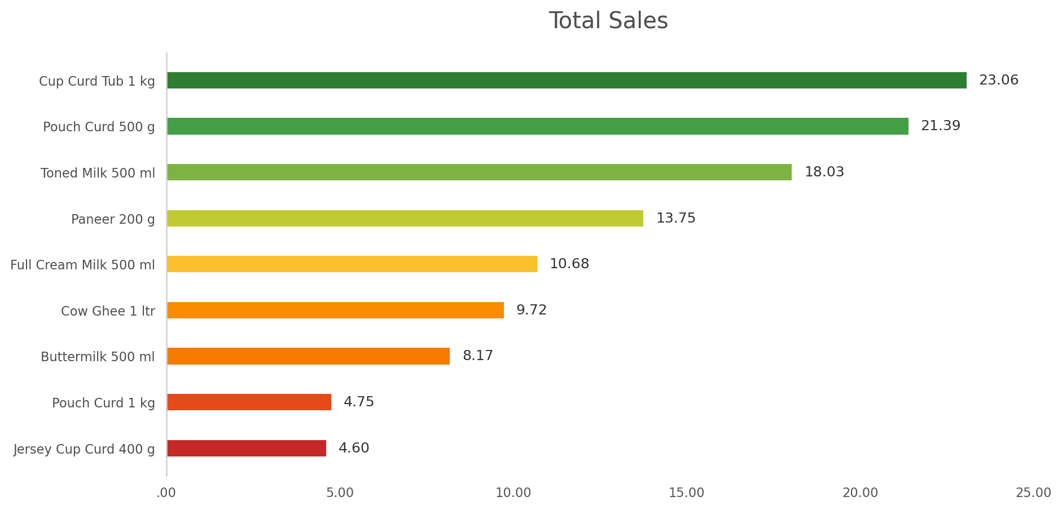
◧ PLATFORM DEEP-DIVE · 01
BLINKIT
Efficient on ROAS, softened on top-line
June '26 · Milk, Paneer & Curd — search and recommendation ads
TOTAL SALES
AD SPEND
ROAS
ACOS (calc.)
NTB CUSTOMERS
₹1.32 Cr
₹7.31 L
6.35x
15.7%
10,332 (11.0%)
▼ 18.4% vs May
CPM ₹366
Best of 3 platforms
Healthy vs cat.
Generic KWs = NTB engine (19.3%)
Category performance - June '26
Top revenue SKUs — Jun '26
CATEGORY | AD SALES | AD SPEND | ROAS | ACOS
Milk | ₹20.8 L | ₹3.02 L | 6.89x | 14.5%
Curd | ₹15.4 L | ₹1.92 L | 8.00x | 12.5%
Paneer | ₹10.3 L | ₹2.38 L | 4.33x | 23.1%
TOTAL | ₹46.5 L | ₹7.31 L | 6.35x | 15.7%
Search vs Recommendation split
Key read-outs
TYPE | SPEND | AD SALES | ROAS | NTB % | ACOS
Search (Generic) | ₹5.25 L | ₹23.2 L | 4.41x | 19.3% | 22.7%
Recommendation | ₹2.07 L | ₹23.3 L | 11.28x | 3.1% | 8.9%
▸
Recommendation ads deliver 11.3x ROAS at 1/3rd the spend of Search but NTB is an issue.
▸
Curd is the star: 8.0x ROAS & only 12.5% ACOS. Milk close behind at 6.9x.
▸
Paneer drags: 4.3x ROAS / 23% ACOS - CPM ₹470 vs milk ₹332. Bid discipline needed.
▸
Generic KWs power NTB acquisition (19.3% NTB) - retain despite lower ROAS.
Source: Blinkit Godrej Jersey Performance Report — June '26 · ACOS shown is calculated (Spend ÷ Ad Sales) per instruction.

Slide 6
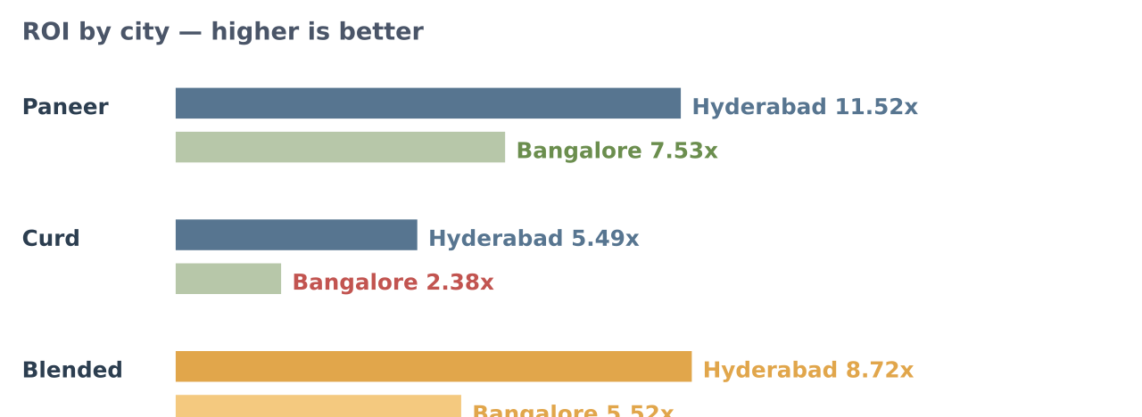
◧ PLATFORM DEEP-DIVE · 02
SWIGGY INSTAMART
Our efficiency engine - compounding since April
June '26 · Bengaluru + Hyderabad focus · Paneer & Curd
TOTAL SALES
AD SPEND
ROAS / ROI
ACOS
AD-SALES SHARE OF GMV
₹1.80 Cr
₹4.25 L
7.37x
13.6%
17.4%
▲ 23.2% vs May
CPM ₹648 · CTR 11.9%
Highest of 3 platforms
Efficient tier
Head-room: highest of 3 platforms
Campaign format performance
City-level performance (Paneer + Curd)
FORMAT | SPEND | AD SALES | ROI | ACOS
SP - Search | ₹2.81 L | ₹20.1 L | 7.16x | 14.0%
SILB - Browse (Curd) | ₹94.9 K | ₹5.04 L | 5.31x | 18.8%
Browse Boost | ₹48.4 K | ₹6.14 L | 12.67x | 7.9%
Category cut — Paneer is the workhorse
Key read-outs
CATEGORY | SPEND | AD SALES | ROI | GMV | AD %
Paneer | ₹2.08 L | ₹20.6 L | 9.94x | ₹57.6 L | 35.8%
Curd | ₹2.17 L | ₹10.7 L | 4.92x | ₹46.7 L | 22.8%
Milk / Ghee / Badam | Directional only – No ads spends
▸
Hyderabad is 1.5–2.3x more efficient than Bengaluru across Paneer & Curd- budget re-weighting overdue.
▸
Browse Boost (12.67x ROI) is the hidden gem - under-funded at ₹48K.
▸
Paneer over-delivers - 35.8% of Paneer GMV from ads at 9.94x ROI.
▸ Curd on SILB (5.3x) > Curd on Search (2.68x) - April format shift is paying
.
Source: Swiggy Instamart Godrej Jersey Performance Report — June '26.

Slide 7
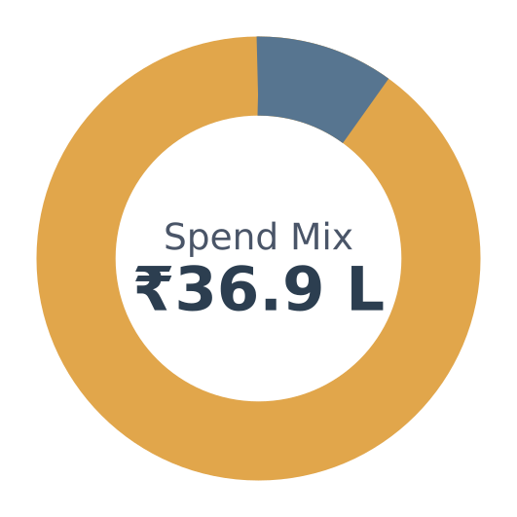
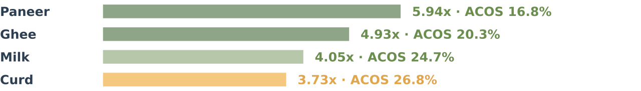
◧ PLATFORM DEEP-DIVE · 03
ZEPTO
Our volume engine - efficiency to be unlocked
June '26 · 62% of Q-comm GMV · SP + SB campaigns · Hyderabad-heavy footprint
TOTAL SALES
AD SPEND
ROI
ACOS
AD SALES / GMV SHARE
₹5.17 Cr
₹36.9 L
4.31x
23.2%
₹1.59 Cr · 30.7%
▼ 4.4% vs May peak
CPC ₹14.5 · 5.2M impressions
Lowest of 3 — headroom
Highest — needs discipline
424K orders · ATC rate 84.6%
Ad type split — SB dominates delivery
City-level performance
TYPE
SPEND
AD SALES
ROI
ACOS
CITY | SPEND | AD SALES | ROI | ACOS | SPEND %
Hyderabad | ₹23.2 L | ₹1.20 Cr | 5.16x | 19.4% | 67%
Bengaluru | ₹10.7 L | ₹27.9 L | 2.60x | 38.4% | 31%
Chennai | ₹0.59 L | ₹5.39 L | 9.13x | 11.0% | 2%
SB
₹33.3 L
₹1.47 Cr
4.40x
22.7%
SP
₹3.60 L
₹12.5 L
3.46x
28.9%
SB carries 90% of Zepto spend. Started reinforcing on SKT keywords (per April action) — SB now the workhorse. SP tail needs targeting refinement.
▲ Bengaluru is 2.0x less efficient than Hyderabad on every category — biggest leak on Zepto.
Category ROI — Paneer & Milk lead
Key read-outs
▸
Chennai is a hidden efficient market (9.1x ROI) - scale from ₹59K spend.
▸
Bengaluru drags blended ROI : 2.60x + ACOS 38% + CPC ₹19.3 (vs Hyd ₹12.7).
▸
Curd is over-consumed on ads (26.8% ACOS) - pull back on generic; retain SKT.
▸ Milk budget consumed of allocation - needs re-planning, not tighter throttle.
Source: Zepto Godrej Jersey Performance Report — June '26.

Slide 8
▤ CATEGORY INTELLIGENCE
CROSS-PLATFORM
Where each category earns its keep
ROI matrix by category × platform (June '26) — showing where to press and where to protect
CATEGORY | BLINKIT ROAS | SWIGGY ROI | ZEPTO ROI | STRATEGIC ROLE
🥛 Milk | 6.89x | n/a | 4.05x | Daily-need anchor · morning day-parting winner (per May playbook)
🥣 Curd | 8.00x | 4.92x | 3.73x | Volume + margin balance · SILB > SP on Swiggy
🧀 Paneer | 4.33x | 9.94x | 5.94x | Highest efficiency on Swiggy · biggest scale headroom on Zepto
Category × platform winners — where to double down
DEFEND · Blinkit — Milk + Curd
EXPAND · Swiggy — Paneer
TIGHTEN · Zepto — Curd + Milk
6.9–8.0x ROAS
9.94x ROI · 35.8% ad-share
ACOS 24–27%
CATEGORY LEADERS
CATEGORY BEST-IN-CLASS
EFFICIENCY OPPORTUNITY
Retain top-2 scroll placement · refine Recommendation ads for better NTB · maintain SP on SKT keywords through evening slots.
Replicate SILB/Browse Boost formats
Cut generic-KW bleed · Protect only SKT + branded queries · Reallocate freed spend to Paneer.
ROAS/ROI = Ad Sales ÷ Ad Spend. "n/a" = category-level split not reported at that granularity on that platform.

Slide 9



✓ WHAT WORKED
H1 PLAYBOOK
Actions that moved the numbers
Three optimization moves in Feb, Apr & May — impact shown as observed correlation, not guaranteed causality
FEBRUARY
APRIL
MAY
Doubled down on scroll‑1 & scroll‑2 winners
Format shift: SILB + SB on SKT keywords
Day‑parting to peak saliency hours
WHAT WE DID
WHAT WE DID
WHAT WE DID
▸ Redirected spend from top‑slot bidding wars into campaigns already delivering healthy GMV
▸ Moved budget from SKT + generic keywords into
SILB / stronger visibility formats
▸ Campaigns live at peak saliency 6 AM – 11 AM for
Milk, Paneer & Curd
▸ Optimized for first & second scroll visibility instead of paying
premium for slot 1
▸ Started running SB campaigns on SKT keywords
- no longer relying on SP alone
▸ Split into morning + evening slots for cleaner readings
▸ Held creative and audience - only shifted bid + budget
▸ Kept a defensive SP layer for branded & deep‑funnel intent
▸ Identified "sweet hours“ - low competition, high visibility
at low CPM
OBSERVED CORRELATION
OBSERVED CORRELATION
OBSERVED CORRELATION
+38%
+11.8%
9.61x
6.15x
+15.5%
+24.7%
Mar Blinkit GMV vs Feb
(₹1.11 Cr → ₹1.54 Cr)
Mar Zepto GMV vs Feb
(₹3.50 Cr → ₹4.55 Cr)
Swiggy Browse Boost ROI
vs 4.08x on Search
Zepto SB ROI
vs 4.56x on SP
Zepto GMV May vs Apr
(₹4.69 Cr → ₹5.41 Cr)
Swiggy GMV May vs Apr
(₹1.17 Cr → ₹1.46 Cr)
Both platforms rebounded after the Feb trough - bid discipline held CPMs while scroll‑1/2 impressions grew.
Zepto SB now delivers 90% of platform ad sales.
May was peak month for Zepto (₹5.41 Cr) and Swiggy accelerated further into June - day‑parting is now a repeatable lever.
MoM lifts derived from monthly Total Sales grand totals in each platform's SKU Level Sales sheet · action‑impact framed as observed correlation, not guaranteed causality.

Slide 10
✕ WHAT DIDN'T WORK · LEAKS TO FIX
H1 GAPS
Where efficiency is leaking
Five friction points visible in the June numbers — each with a proposed fix for H2
PLATFORM | LEAK / ISSUE OBSERVED | METRIC EVIDENCE | PROPOSED FIX FOR H2
Blinkit | Paneer ACOS is 1.7x category average - high CPM, low conversion depth | CPM ₹470 vs Milk ₹332 · ACOS 23.1% · ROAS 4.33x | Cap generic bids on Paneer · shift 20% into Recommendation ads (11.3x ROAS)
Blinkit | June GMV dropped −18% MoM - softness after April slot re‑shuffle | May ₹1.62 Cr → Jun ₹1.32 Cr · lost momentum | Maintain top scroll visibility instead fighting for 1-3 MVP
Swiggy | Curd on SP search is inefficient vs SILB - spend concentrated on high ACOS format | Curd SP ROI 2.68x · ACOS 37.3% (highest single cut) | Shift 40% of Curd SP budget into SILB (5.3x) & Browse Boost (12.7x) · retain SP only on top keywords
Swiggy | Budget under‑consumed on high‑ROI Hyderabad Paneer, over‑spent on lower‑ROI cuts | Curd spend 2.17x of allocation vs Paneer only 1.04x | Rebalance monthly budget in favor of Paneer‑HYD · introduce dynamic caps on Curd‑BLR
Zepto | Bengaluru is the single biggest efficiency leak across every category | BLR ROI 2.60x · ACOS 38% · CPC ₹19.3 (Hyd ₹12.7) | Fix BLR spend 25% & HYD dayparts
Zepto | Generic keywords over‑consuming Curd + Milk spend | Generic KWs = 85% of Zepto ad spend · ROI 4.44x, ACOS 22.5% | Trim generic long‑tail · protect SKT + branded · redeploy freed spend to Paneer + Ghee (higher ROI)
All metrics from June '26 platform reports · ACOS = Spend ÷ Ad Sales · fixes are proposals; expected impact to be validated post‑implementation.

Slide 11
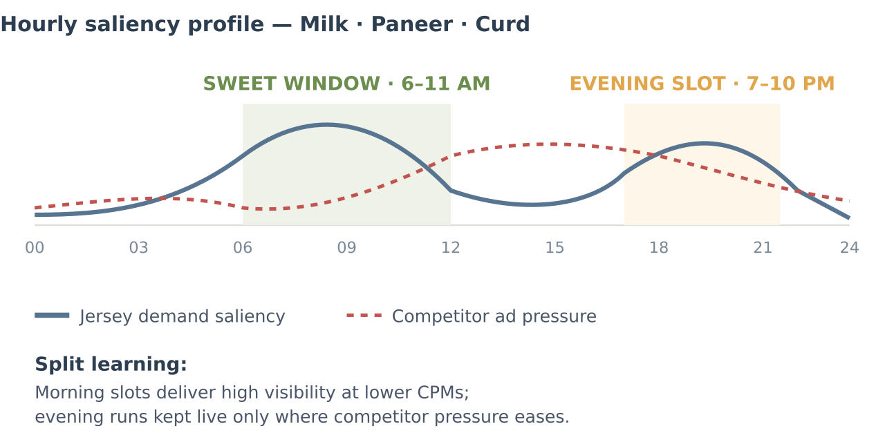
◈ GEO & DAY-PART INTELLIGENCE
PERFORMANCE INTEL
Where & when spend earns most
City efficiency (Zepto + Swiggy) and the day‑parting effect discovered in May
City-level ROI — June '26
Day-parting - the "sweet hours" learning from May
CITY | PLATFORM | SPEND | ROI | ACOS
Chennai | Zepto (Ghee-led) | ₹0.59 L | 9.13x | 11.0%
Hyderabad | Swiggy (Paneer) | ₹1.26 L | 11.52x | 8.7%
Hyderabad | Zepto (all) | ₹23.24 L | 5.16x | 19.4%
Bengaluru | Swiggy (Paneer) | ₹0.82 L | 7.53x | 13.3%
Bengaluru | Zepto (all) | ₹10.74 L | 2.60x | 38.4%
Bengaluru | Swiggy (Curd) | ₹0.34 L | 2.38x | 41.9%
City read-outs
Impact signals (May → Jun window)
▸
Chennai + Hyderabad-Paneer are the two most efficient rupees we deploy
- both under-funded relative to potential.
▸
Hyderabad is the anchor market: 67% of Zepto spend, 2.0x more efficient than Bengaluru.
+15.5%
Clean AM/PM
Lower CPMs
▸
Bengaluru shows a consistent inefficiency signature across BOTH platforms → market-level issue (CPC premium, weaker conversion), not a platform artefact.
Zepto GMV lift in May post day-parting
Split campaigns enabled attribution clarity per slot
Sweet-hour bids ~15–20% below auction average
▸ Recommendation: −25% BLR spend, redeploy to CHE + HYD dayparts in H2.
Day-part curves are illustrative reconstructions of the May "sweet hours" learning; MoM impact from platform SKU-level sales sheets. Correlation not causality.

Slide 12
➤ WAY FORWARD · H2 2026
STRATEGIC PILLARS
Five pillars for H2 scale-up
Concrete moves on format mix, city allocation, day-parting, SKU discipline & measurement
01
02
03
04
05
Format Rebalance
City Re-allocation
Day-part Rollout
SKU Discipline
Measurement Uplift
GOAL
GOAL
GOAL
GOAL
GOAL
Grow SILB / Browse / SB share from ~65% today to
Route the next rupee to its most efficient city.
Take May's "sweet hours" playbook cross‑platform.
A single SKU tiering framework across all 3 platforms.
Faster feedback loops.
≥ 80% by Dec
.
MOVES
MOVES
MOVES
MOVES
MOVES
▸ Weekly ROAS+ACOS scorecard per platform
▸ Extend April format shift to Blinkit + Zepto Curd
▸ Bengaluru Zepto spend: −25%
▸ Deploy 6–11 AM slot on Blinkit for
Milk/Paneer/Curd
▸
A-tier (top 20% by GMV): ROAS floor 5x,
protect at all costs
▸ Chennai (9.1x ROI): scale from ₹0.6L → ₹2L
B-tier : efficiency-testing zone, day-parted
▸ Clean AM/PM tagging for every campaign
▸ Scale Swiggy Browse Boost (₹48K → ₹1.5L)
▸ Build second slot for Ghee (weekend cook prep)
▸
▸ Extend Paneer‑Hyderabad model on Swiggy to Bangalore + Chennai
▸ Standardize ACOS calc across sheets
▸ Retain SP only for branded & deep-funnel intent
▸ Split every category into AM/PM sub‑campaigns
▸
C-tier
: harvest visibility, no paid support
▸ Add NTB % tracking on Swiggy/Zepto
TARGET
TARGET
TARGET
TARGET
Blended ACOS 20% → 17%
TARGET
Free up 8–10% of spend for reinvestment
Optimization cycles: monthly → weekly
+0.6x lift on blended ROAS
Recover Blinkit MoM: +15% by Aug
Targets are directional H2 goals framed from H1 signal · to be re-baselined at end of July after first month of execution.

Slide 13
▸ OPERATIONAL ROADMAP
JUL '26 → DEC '26
H2 Tactical Roadmap
Monthly execution plan — the five pillars translated into calendar‑anchored actions
MONTH | THEME | KEY EXECUTION ACTIONS | TARGET ROAS | TARGET GMV (Cr)
Jul '26 | Baseline & Fix Blinkit | Roll out 6–11 AM day-parting on Blinkit · Cap Paneer generic bids · Weekly ROAS scorecard live | 4.90x | ₹8.6 Cr
Aug '26 | City Rebalance - Zepto | −25% Bengaluru spend · scale Chennai to ₹1.5L · A-tier SKU floors enforced across platforms | 5.10x | ₹9.0 Cr
Sep '26 | Swiggy Paneer Expansion | Extend HYD Paneer playbook to New cities · Scale Browse Boost from ₹48K → ₹1.5L · Onam / Ganesh push | 5.30x | ₹9.5 Cr
Oct '26 | Festive Peak - Diwali | Ghee-led hero-SKU push (Diwali) · Curd combo bundles · Homepage banner buy on Blinkit + Zepto · SB matched to festive KWs | 5.50x | ₹11.2 Cr
Nov '26 | Post-festive Retention | Retargeting to acquired NTB (Blinkit 10.3K + platform equivalents) · Winter Badam/Buttermilk saliency slot · C-tier SKU harvest live | 5.60x | ₹10.5 Cr
Dec '26 | Year-End Consolidation | Full-portfolio Curd + Paneer defense · New-year buying prep · H1'27 baseline scorecard · learnings archive to brand | 5.70x | ₹11.0 Cr
H2 TOTAL | Cumulative view | Blended ROAS trajectory 4.88x → 5.70x · efficiency gain +17% | 5.30x avg | ₹59.8 Cr
Targets built off H1 run-rate + planned optimization impact. GMV extrapolated from June '26 baseline plus seasonality & efficiency uplift · to be re-forecast after Aug close.

Slide 14
■ ASK FROM BRAND · SUPPORT NEEDED
To execute H2, we need four things
CLOSING NOTE
From reading the numbers,
to shaping them.
Enablers from Godrej Jersey brand team to unlock the full growth plan
ASK 01
Approval to reallocate ~₹8–10 L monthly across platforms & cities without SKU-locked splits - allows Chennai scale-up, Bengaluru pullback/cap, and Swiggy Paneer expansion. Total budget envelope unchanged.
Budget flexibility
H2 NORTH STAR
ASK 02
₹59.8 Cr projected GMV
Paneer + Ghee hero creatives are the same since long - festive season needs fresh visuals, especially for Diwali homepage banners. 2 new creatives/category by mid-Aug (5 categories = 10 assets).
Creative refresh
5.30x blended ROAS
-3 ppt blended ACOS improvement
Every H2 lever is a repeat of a proven H1 signal - nothing untested. The ask is speed & support.
ASK 03
Paneer + Curd hero SKUs need ≥95% fill rate in top cities to support Swiggy expansion. Current OOS incidents in metro dark stores waste high-ROI ad clicks - align with supply team.
Metro fill-rate
ASK 04
Weekly pricing benchmark vs Amul, Heritage, Nandini - high-ACOS moments on Curd correlate with competitor discount events.
Pricing parity view
THANK YOU · QUESTIONS WELCOME
Prepared from June '26 platform reports

